Slide 1
Introduction
Prisha Goel
Grade 12, National Public School, Bangalore
Pranshu Goel
Grade 9, National Public School, Bangalore
We both love coding, esp Python and Java
We love to solve complex problems through algorithms
We want to become computer engineers, and our passion is to design big applications

Slide 2
Problem Statement
Covid-19 has affected both developed as well as developing nations
In India, we are running out of capacity in hospitals
Government has set up several Covid Care Centers (CCC) in major cities
These Centers are equipped with good equipment and staff, but need management software
There is a need to create reports at each level so that information is available to everyone in the system. The status changes every hour, so effective information sharing is a key here
Our piece of code attempts to build an effective solution in a very simple and intuitive manner to manage all the work processes within a Covid Care Center, from the time a patient walks into a center to his/her discharge after treatment. It provides the right level of information to all doctors and medical staff to make the right decision at all times.

Slide 3
What Do We Do
Assign Doctor
Allot Bed
RemoveNurse
Reduce Capacity
Mortality
Add Nurse
Move patients
Status
List of Nurses
Update Vitals
Change Status
Discharge
Remove Doctors
Update Dosage
Permit Discharge
Mortuary
New Patient
See prescriptons
Add Doctor
Modify Prescription
ICUs
Occupied Beds
List of Doctors
Patient Details
Prescribed Medicines
To Be Discharged
Beds Mgmt
List of patients in the ward
Patient Past History
Nurse Mgmt
Under Observe
Add Capacity
Critical Patients
Doctors Mgmt
Active Patients
Mild Patients
Patient State Report
Free Beds

Slide 4
Solution Description – Front End
A set of Python scripts for:
Authentication using username and password
Role-based access control, so each authenticated user only sees what is relevant to him, and not any other operations
Administrative jobs like management of doctors, nurses and capacity
Admission and discharge of patients
Mortuary management
Managing prescriptions by doctors
Managing dosages and measuring and recording vitals, like BP, temperature, etc by nurses
Managing health status of each patient at all times

Slide 5
Solution Description - Backend
Backend database to store
Doctors’ records and availability
Nursing staff information
Active patients
Records of doctor’s prescriptions
Records of dosages given
Historical records of recovered and discharged patients
Historical records of mortalities

Slide 6
Code Structure
Main.py – This is the main entry point of the program, which handles the user authentication and assigns role-based operations. It invokes the other Python files based on the role.
Doctor.py – This gets invoked if the authentication process identifies the user as a doctor. This gives the doctors access to the patients files and update prescriptions.
Nurse.py – This gets invoked if the user is a nursing staff. It is used to check the prescription and to administer dosages
Admin.py – This is used by the center administrators to add capacity, doctors or nurses
Clerk.py – This gets invoked for the clerks for admission and discharge of the patients
DB.py – This is a one-time script to create the database tables

Slide 7
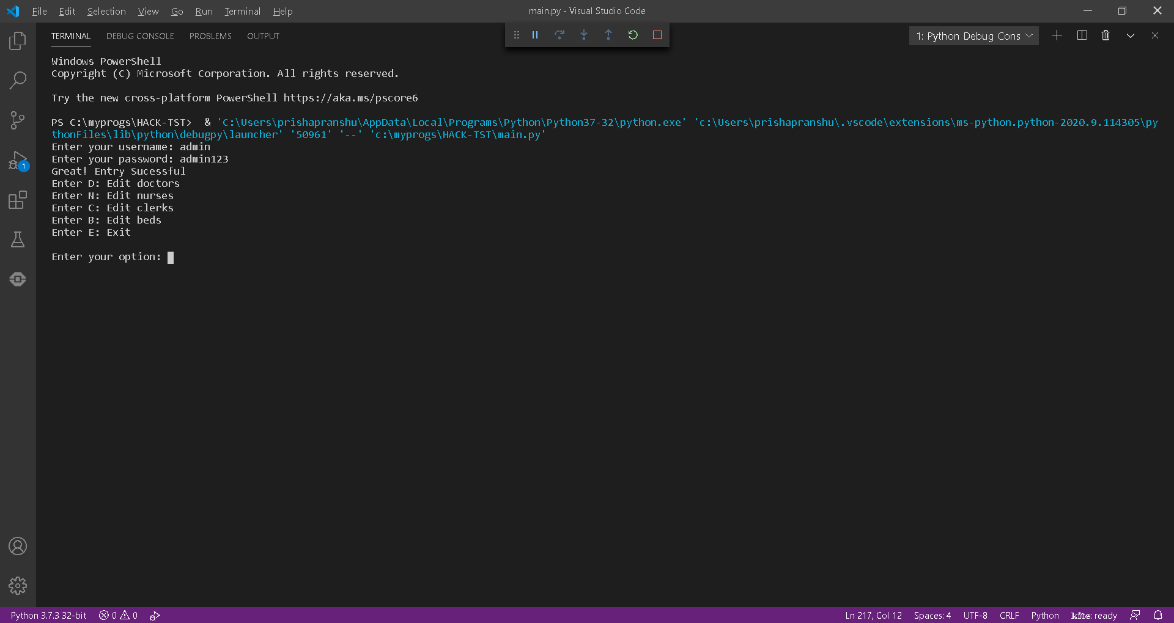
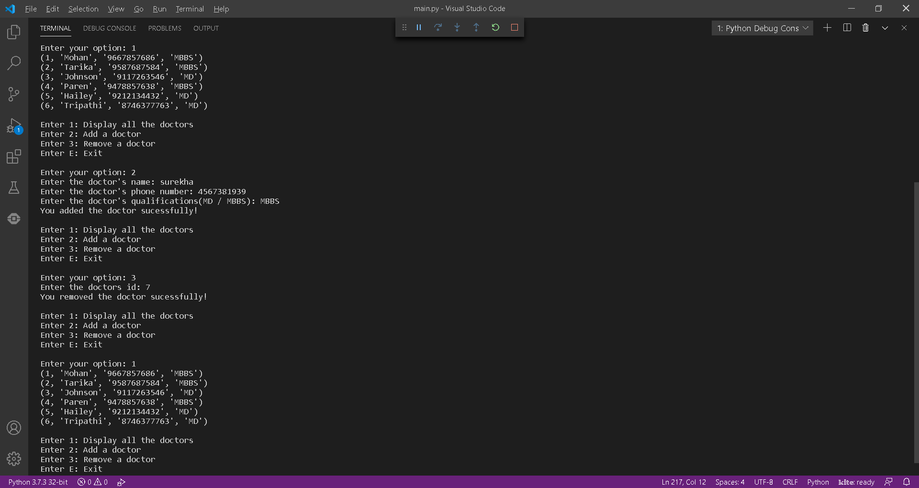
Screenshots

Slide 8
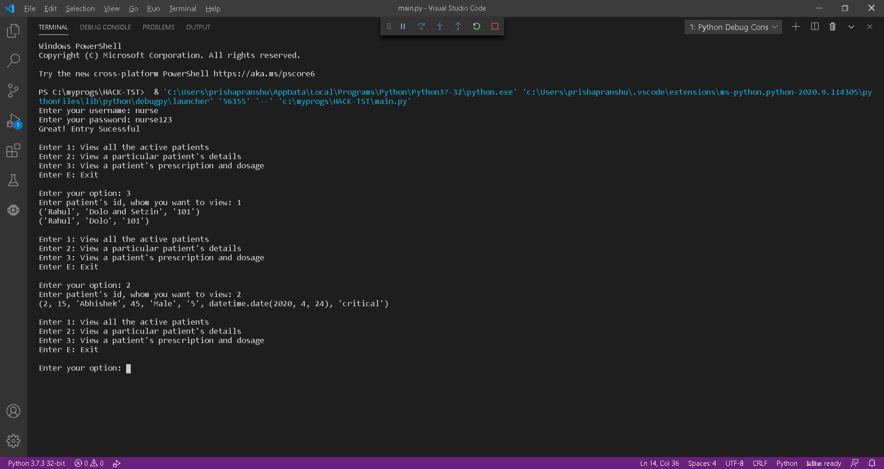
Screenshots

Slide 9
Further Development
Covert into a more intuitive GUI interface from a text based interface
Look at converting into a web application, so that it can be rendered over a web browser
Provide an Android and/or iOS app so that staff can access the key features from their mobiles
We need to refine the way the staff administers patients’ medicine dosages
Look at ways to make inter-center communication possible so that various covid care centers can share information about beds availability as well as treatment methodologies
We need to provide an LDAP/Directory based stronger authentication instead of the current DB based one
We need to comply with regulations like HIPAA in handling patient records

